Slide 1
NON-CONVENTIONAL ENERGY RESOURCES

Slide 2
Fossil fuels Environmental impact

Slide 3
Increase in demand for energy due to rapid industrialization and growing population

Slide 4
Limited reserves of coal and consequent burden on foreign exchange due to increasing imports

Slide 5
Constraints of financial resources for enhancing the infrastructure facility

Slide 6
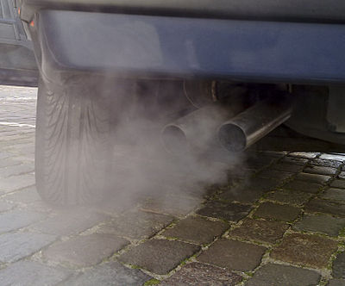

Slide 7
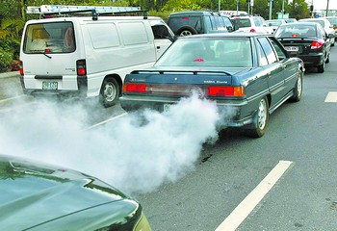

Slide 8
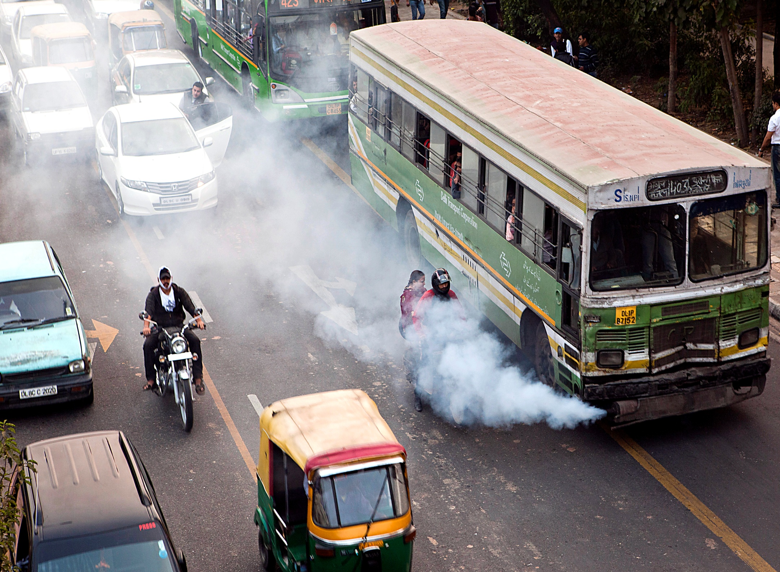

Slide 9
Energy scenario

Slide 10
According to an assessment, the rise in the average global temperature will be between 1 to 3.5 degree by the end of 2100.
This represents an average rate of global warming greater than any in the last 10,000 years.

Slide 11
India’s energy development programme has been put to severe pressure with the increasing demand supply gap and mismatch of resources coupled with non-uniform growth curve.
The challenges faced by India in the management and development of the power sector are multi dimensional and they stem fundamentally from the following

Slide 12
1) Increase in demand for energy due to rapid industrialization and growing population 2) constraints of financial resources for enhancing this infrastructure facility 3) Limited reserves of coal and fossil fuels and consequent burden on foreign exchange due to increasing imports.

Slide 14
Total India’s installed capacity as on 30-06-2017 in MW Thermal 220575 Nuclear 6780 Hydro 44614 RES 57260

Slide 15
State Sector 94,153 37.10 Central Sector 68,993 27.20 Private Sector 90,903 35.30 2,54,049 MW

Slide 16
Total Thermal 176779 69.60

Slide 17
Coal 152971 60.20 Gas 22608 8.9 Oil 1200 0.50

Slide 18
Hydro (Renewable) 40799 16.10 Nuclear 4,700 1.90 RES** (MNRE) 31692 12.50 Total 2,54,049

Slide 19
Renewable energy – Any sustainable energy source that comes from natural environment.
it is renewable it is therefore sustainable and so will never run out.
It is abundant in nature.
Ready to be harnessed and inexhaustible.
It is a clean alternative to fossil fuels.

Slide 20
Even more importantly, renewable energy produces little or no waste products such as carbon dioxide or other chemical pollutants, so has minimal impact on the environment. Renewable energy projects can also bring economic benefits to many regional areas, as most projects are located away from large urban centers and suburbs of the capital cities. These economic benefits may be from the increased use of local services as well

Slide 21
Renewable energy sources wind power wave power Ocean Thermal Exchange Capacity (OTEC) solar power Hydropower fuel cells Bio fuels Biomass energy Tidal energy Geothermal energy biogases

Slide 22
The special characteristics of renewable energy that make it attractive are 1) Decentralized production 2) Modular in use involving large number of producers and consumers 3) Zero or low cost fuels 4) Low gestation period, providing quicker benefits 5) Socially relevant and useful 6) Economically viable and financially sound 7) Provides energy security to developing economies.

Slide 23
Advantages of Renewable energy sources

Slide 24
1) These sources of energy ( solar, Wind, OTEC, Geothermal, Biomass ) are non polluting, so they have no adverse influence on the environment. They are freely available. 2) These sources are inexhaustible and renewable in nature. 3) Though the initial cost of the installation is high , but after a pre determined period the power output is almost free. 4) wind energy systems avoid fuel cost and transport.

Slide 25
5) Solar Energy collection devices can be installed at any location and hence the site selection is not a difficult problem . 6) In the case of biomass energy systems, the processing of biomass for fuel from sewage and waste reduces the environmental hazards. Hence in rural areas hygiene and sanitation conditions are improved. 7) Geothermal energy has practically no intermittency and has the highest energy density. 8) The extraction of wave energy is pollution free totally and leaves the water in a relatively calm state in their wakes.

Slide 26
9) Tidal power plants do not demand large areas of valuable land because they are on the bays( sea shores) . 10) These non conventional energy systems can either be used individually or in combinations. 11) In the case of solar energy collection devices the energy density can be increased by concentrating more radiation on the absorber plate by using focusing mirrors. The Non Conventional Energy sources can be the only substitute for fossil fuels in the future as the fossil fuels near getting exhausted and slowly the world is heading towards energy crises because these sources does not have the problem of waste disposal when compared to the nuclear fuels.

Slide 27
Barriers in Renewable Energy Development 1) Risks involved in transforming technologies to mainstream. 2) Easy availability of conventional energy with established networking arrangements. 3) stiff competition from subsidized conventional energy and its universal acceptability. 4) Lack of large scale production facilities. 5) High capital investment and marginal commercial viability.

Slide 28
6) Lack of marketing mechanism. 7) Less number of major players in the industrial segment. 8) lack of awareness. 9) Limited access to financial resources and high cost of finance. 10) Lack of trained manpower.

Slide 29
Wind energy

Slide 30
A wind turbine is a machine for converting the kinetic energy in wind into
mechanical energy.

Slide 31
If the mechanical energy is used directly by machinery, such as a pump or grinding stones, the machine is usually called a windmill.

Slide 32
If the mechanical energy is then converted to electricity, the machine is called a wind generator.

Slide 33
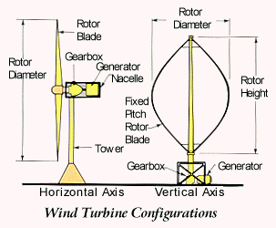

Slide 34
Planetary and local winds

Slide 35
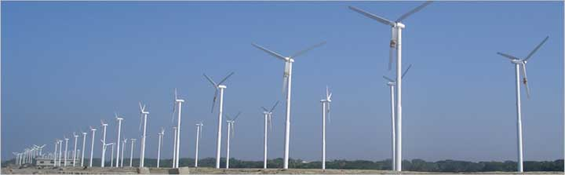

Slide 36
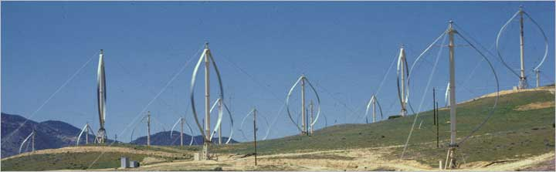

Slide 37
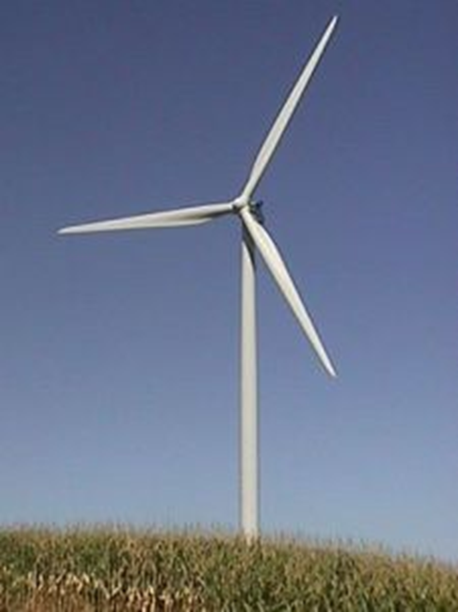

Slide 38
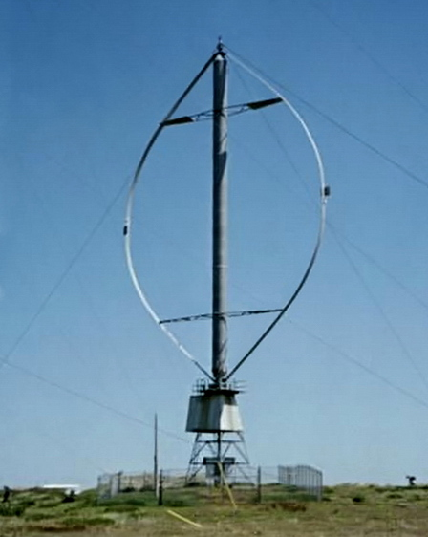

Slide 39
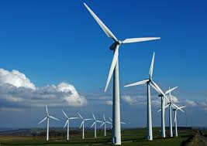

Slide 40
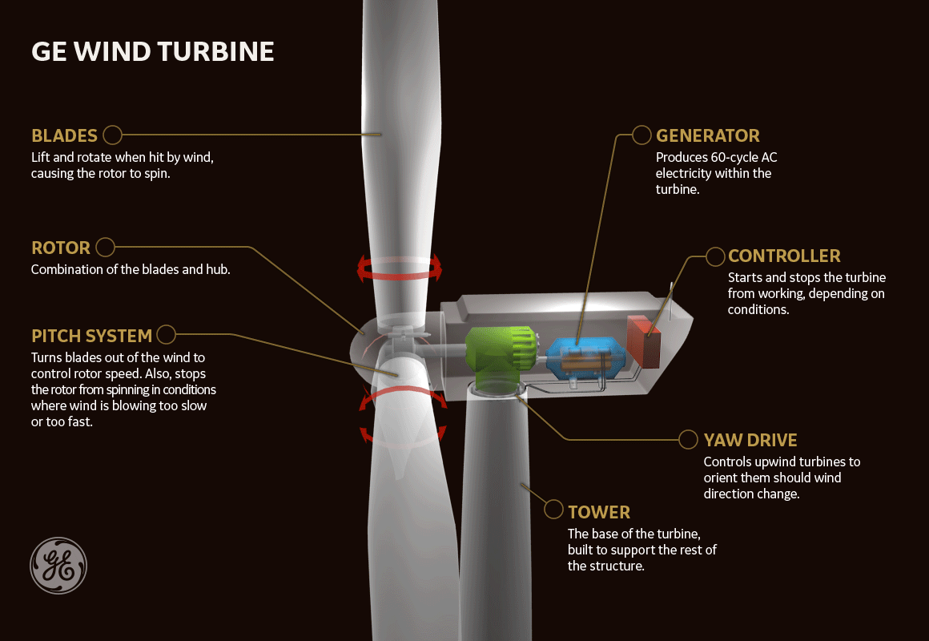

Slide 42
1.A wind turbine obtains its power input by converting the force of wind into a torque (turning force) acting on the rotor blades. 2.The amount of energy which the wind transfers to the rotor depends on the density of the air, rotor area and the wind speed.

Slide 43
P= 1/2pAV3

Slide 44
A wind turbine is capable of converting only 59.26% of the total power of wind to useful mechanical power of the turbine. Betz Maxima (or) Power coefficient

Slide 45
The exit velocity of wind from the turbine in no case can exceed 1/3 0f the inlet velocity of wind

Slide 46
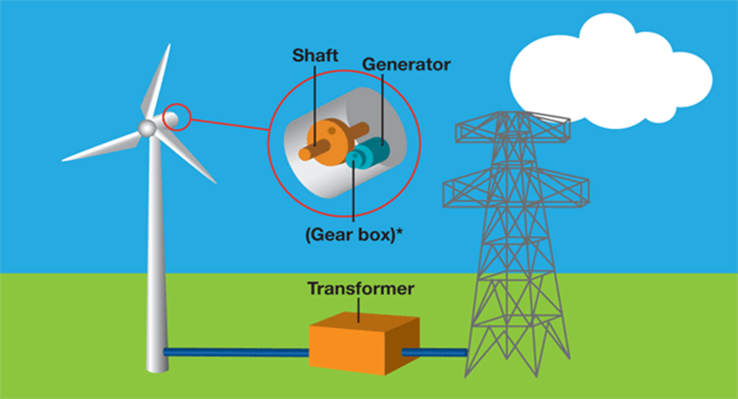

Slide 47
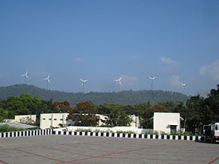

Slide 48
1. Wind power - fastest growing renewable source. Globally, it grew at the average rate of 25% in the past 10 years. 2.While in India it grew at a rate of 33% over 9 years. Presently India is ranked 4th in terms of wind energy installed capacity. Drivers of growth: 1.Environmental awareness and sustainable development. Growing global energy demand. 2. Carbon trading

Slide 49
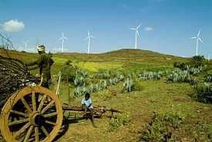

Slide 50
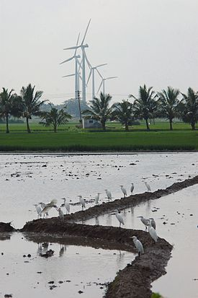

Slide 51
As of the end of October 2017 the total installed wind power capacity was 32.72 GW,

Slide 52
Incidentally, Mytrah has been running the sole wind energy plant in Telangana at Nazeerabad in Parigi mandal with 48 turbine units spread over 25 km radius and spread over 13 villages generating 108 MW power successfully for last 18 months.

Slide 53
Wave power

Slide 54


Slide 55
India has a long coastline of 7517 km^{[1]} marked along by numerous estuaries and gulfs which makes it attractive for the development of marine energy projects. India's wave power potential is around 40-60GW.^{[2}

Slide 57
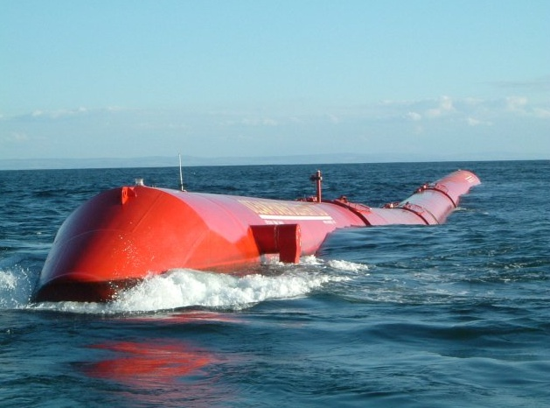

Slide 58


Slide 59
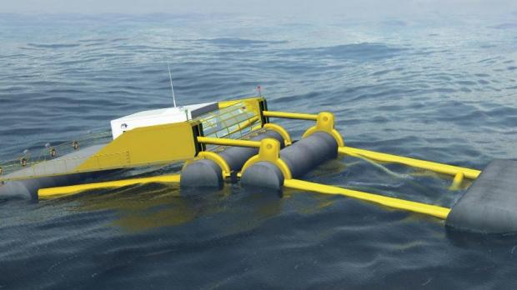

Slide 60
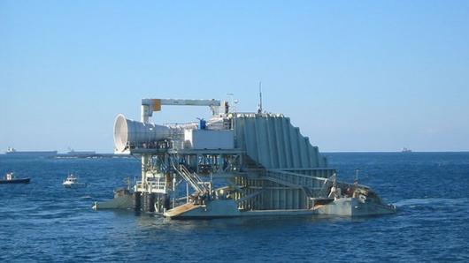

Slide 62
Ocean Thermal Exchange Capacity (OTEC)

Slide 63
This is a method of generating electricity which uses the temperature difference that exists between deep and shallow waters to run a heat engine. The greatest efficiency and power is produced with the largest temperature difference, and this is found in the tropics and near the equator

Slide 64
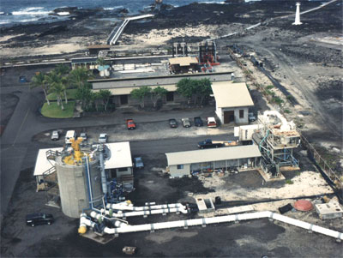
View of a land based OTEC facility at Keahole Point on the Kona coast of Hawaii.

Slide 65
Makai Ocean Engineering's ocean thermal energy conversion (OTEC) power plant is the world's biggest operational facility of its kind, with an annual power generation capacity of 100kW, which is sufficient to power 120 homes in Hawaii.

Slide 66


Slide 67
solar power

Slide 68
The sun is the source of energy that drives the cycle of life and death on earth. It is also the energy source that gives us warmth and evaporates water and melts snow

Slide 69
The sun is our nearest star. It is about 150,000,000 km away from the Earth. Due to its immense, but finite size, it has an angular diameter of 0.5 degree (32 minutes), as viewed from Earth. The Sun burns continuously via thermonuclear reactions (fusion). Inside the sun, radiative processes transfer this energy from 0.3 to 0.7 radii. Convection transfers solar energy to its exterior surface. Despite the extremely high temperatures needed at the core of the sun, to sustain its thermonuclear reactions, the sun has a black body temperature of 5770 K. Consequently, we receive a relatively constant flux density of energy, defined as the Solar Constant. Its mean value is 1366 W m-2 .

Slide 70
1. Solar energy is by far the earth’s most available energy source, easily capable of providing many time the total current energy demand. 2. Solar power is the conversion of sunlight into electricity. Two main commercial ways of conversion of sunlight into electricity: Concentrating solar thermal plants (cps) Photovoltaic plants (pv)

Slide 71
Last week, a solar power plant in Kamuthi, Tamil Nadu became the world’s largest plant. With a capacity to produce 648 MW of electricity, the plant comprises 2.5 million individual solar modules.

Slide 72
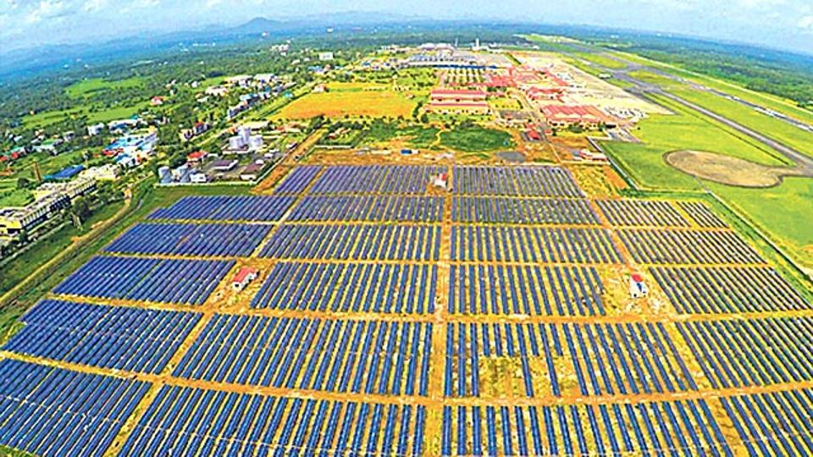

Slide 73
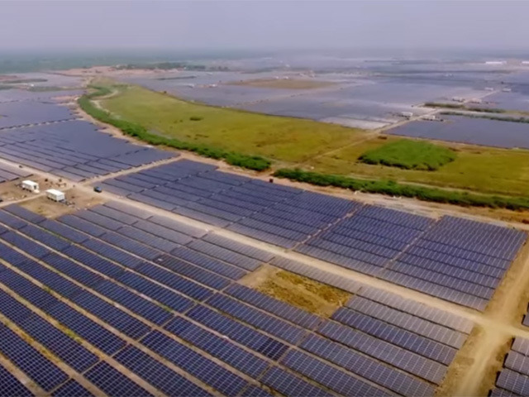

Slide 74
Kurnool is home to the 1,000 MW solar park—the largest single-location operational solar park in the world.

Slide 75
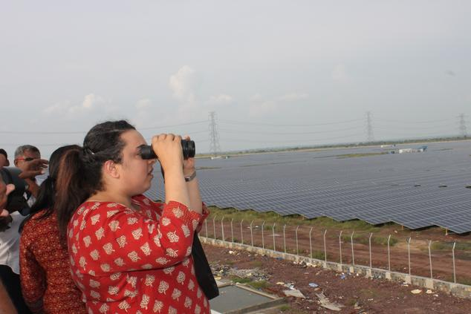

Slide 76
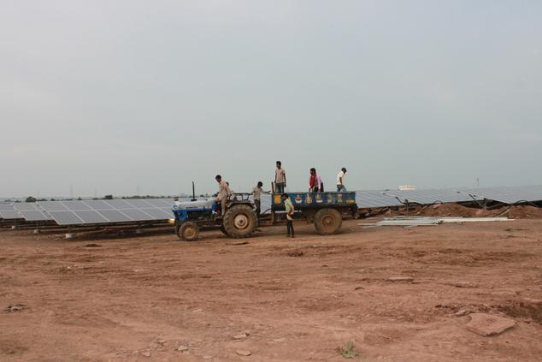

Slide 77
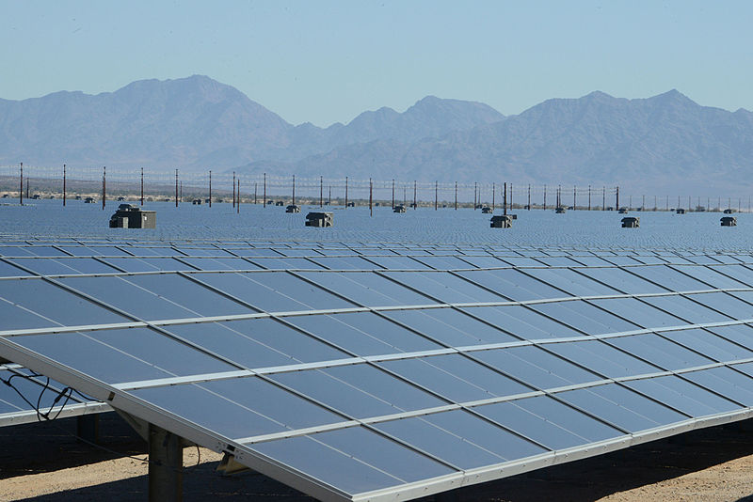

Slide 78
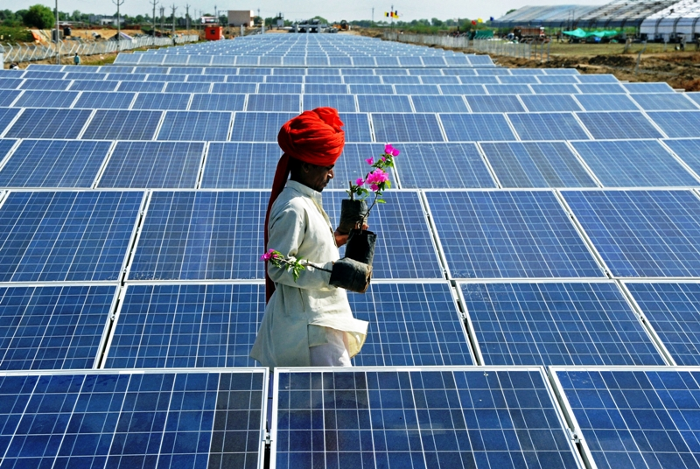

Slide 79
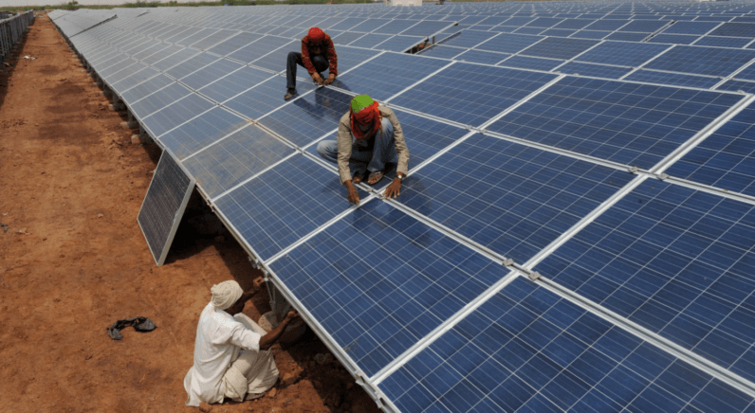

Slide 80
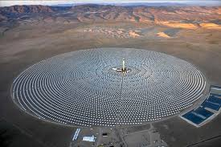

Slide 81
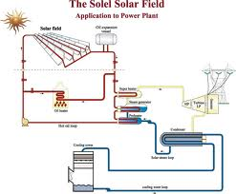

Slide 82
Solar Water Heating Systems
We are blessed with Solar Energy in abundance at no cost. The solar radiation incident on the surface of the earth can be conveniently utilized for the benefit of human society.
One of the popular devices that harness the solar energy is solar hot water system (SHWS).

Slide 83
Flat Plate Collectors (FPC) based Solar Water Heaters Evacuated Tube Collectors (ETC) based Solar Water Heaters

Slide 84
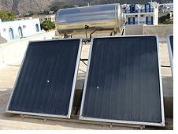

Slide 85
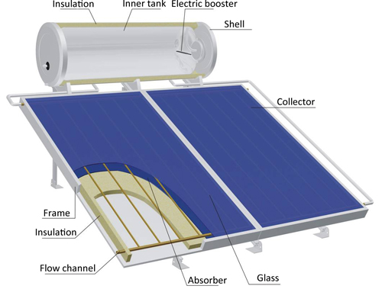

Slide 86
1) Around 60 deg. – 80 deg. C temperature can be attained depending on solar radiation, weather conditions and solar collector system efficiency 2)Hot water for homes, hostels, hotels, hospitals, restaurants, dairies, industries etc. 3) Can be installed on roof-tops, building terrace and open ground where there is no shading, south orientation of collectors and over-head tank above SWH system 3) SWH system generates hot water on clear sunny days (maximum), partially clouded (moderate) but not in rainy or heavy overcast day 4) Only soft and potable water can be used 5) Stainless Steel is used for small tanks whereas Mild Steel tanks with anticorrosion coating inside are used for large tanks 6) Solar water heaters (SWHs) of 100-300 litres capacity are suited for domestic application. 7) Larger systems can be used in restaurants, guest houses, hotels, hospitals, industries etc.

Slide 87
Fuel Savings : A 100 litres capacity SWH can replace an electric geyser for residential use and saves 1500 units of electricity annually. Avoided utility cost on generation The use of 1000 SWHs of 100 litres capacity each can contribute to a peak load saving of 1 MW.

Slide 88
Environmental benefits A SWH of 100 liters capacity can prevent emission of 1.5 tonnes of carbon dioxide per year. Life : 15-20 years Approximate cost : Rs.15000- 20,000 for a 100 litres capacity system and Rs.110-150 per installed litre for higher capacity systems Payback period : 3-4 years when electricity is replaced 4-5 years when furnace oil is replaced 5-6 years when coal is replaced

Slide 89
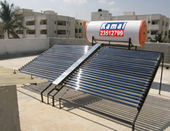

Slide 90
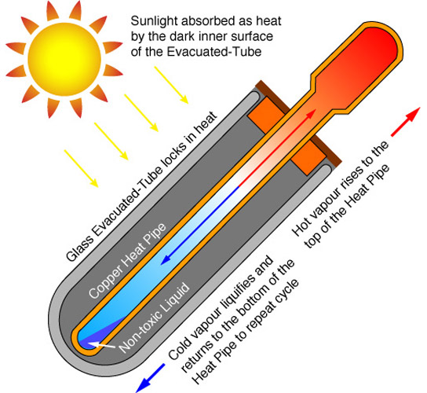

Slide 91
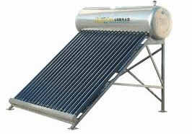

Slide 92
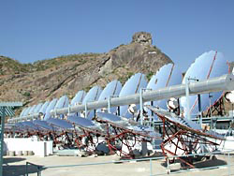

Slide 93
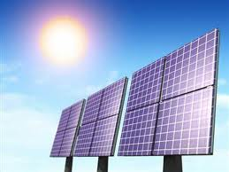
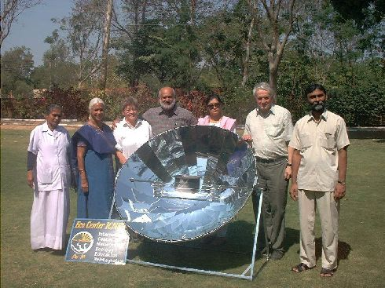

Slide 94
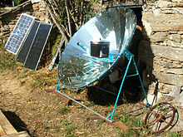

Slide 95


Slide 96
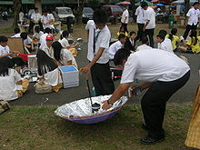

Slide 97
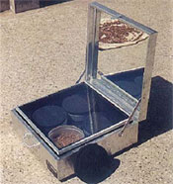

Slide 98
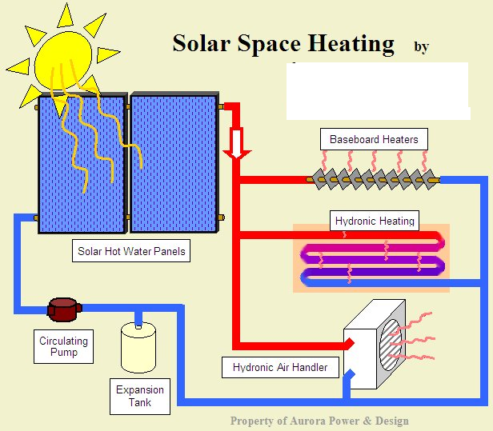

Slide 99
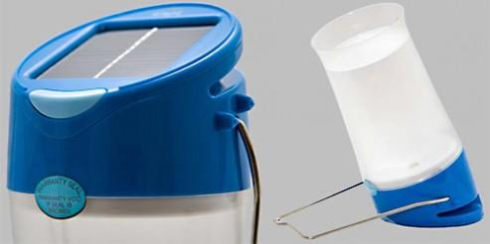

Slide 100
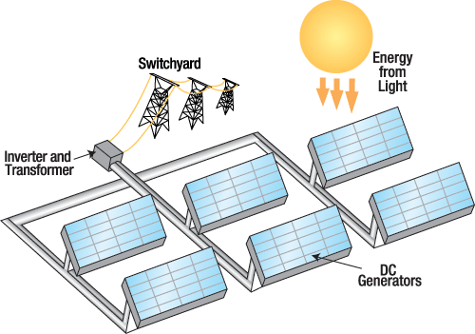

Slide 101
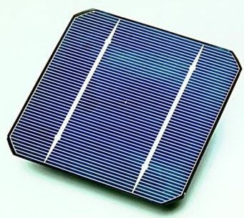
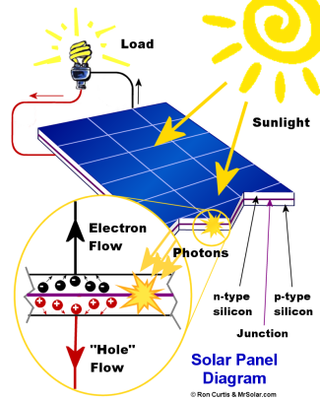

Slide 102
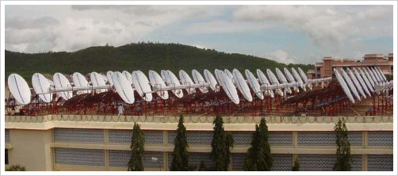

Slide 103
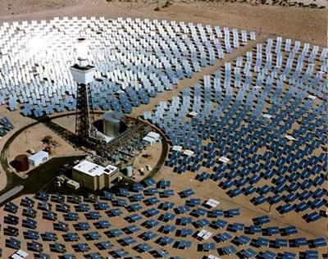

Slide 104
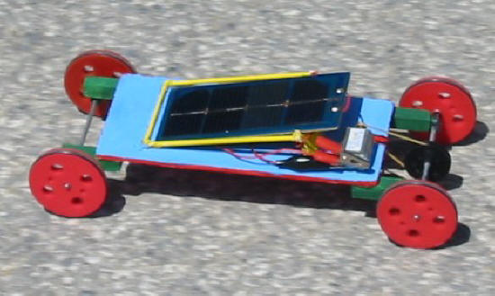

Slide 105
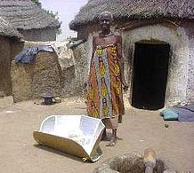

Slide 106
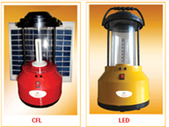

Slide 107
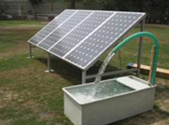

Slide 108
Andhra Pradesh tops in solar power, Telangana fourth

Slide 110
Hydropower

Slide 111
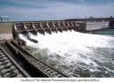

Slide 112


Slide 113
fuel cells

Slide 114


Slide 115


Slide 116


Slide 117
Bio fuels vegetable oils edible oils, non edible oils

Slide 118


Slide 120


Slide 121


Slide 122


Slide 123
Biomass energy municipal solid waste

Slide 124


Slide 125
Tidal energy

Slide 127


Slide 128
Geothermal energy

Slide 129


Slide 130
biogases

Slide 131


Slide 132


Slide 133


Slide 134
Thank You

